Slide 1
CASE STUDY: Credit Card Fraud Detection
SUBMITTED BY : Malathi Ramakrishnan, Vedika Vipul Sole, Jasni Ebrahim, Saba Yunus

Slide 2
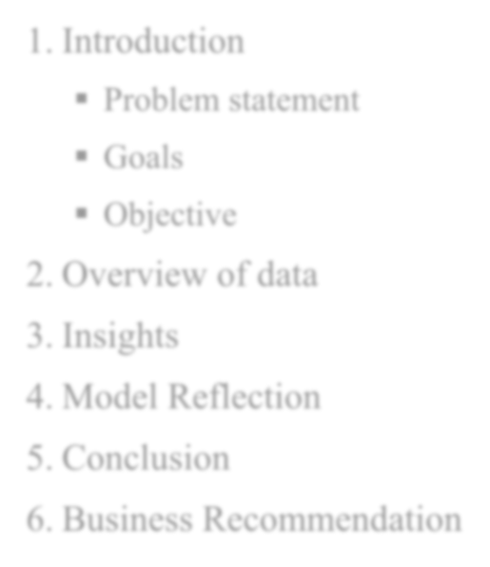
AGENDA
Introduction
Problem statement
Goals
Objective
Overview of data
Insights
Model Reflection
Conclusion
Business Recommendation

Slide 3
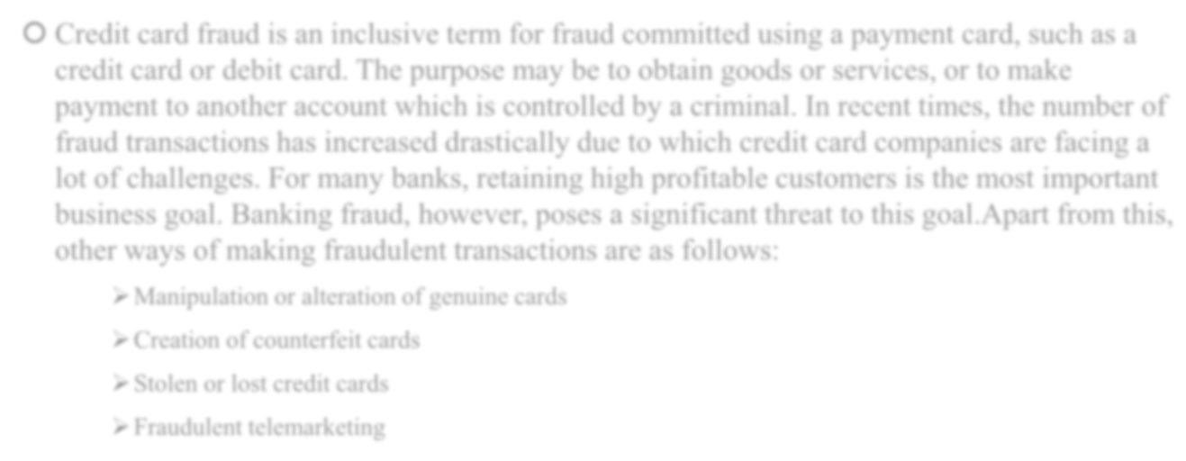
Introduction
🞅 Credit card fraud is an inclusive term for fraud committed using a payment card, such as a credit card or debit card. The purpose may be to obtain goods or services, or to make payment to another account which is controlled by a criminal. In recent times, the number of fraud transactions has increased drastically due to which credit card companies are facing a lot of challenges. For many banks, retaining high profitable customers is the most important business goal. Banking fraud, however, poses a significant threat to this goal.Apart from this, other ways of making fraudulent transactions are as follows:
Manipulation or alteration of genuine cards
Creation of counterfeit cards
Stolen or lost credit cards
Fraudulent telemarketing

Slide 4
Problem statement
🞅 Detecting credit card fraud using machine learning is a must in banking industry.
🞅 They need to put proactive monitoring and fraud prevention mechanisms in place.
🞅 Machine learning fraud detection algorithms are way more effective than humans.
🞅 The concept behind using machine learning for fraud detection is that fraudulent transactions have specific features that legitimate transactions.
Machine learning helps these institutions.
To reduce time-consuming manual reviews.
Costly chargebacks and fees.
Denial of legitimate transactions.

Slide 5
GOALS
1. Work as a part of the analytics team working on a fraud detection model
and its cost-benefit analysis.
Objective : Analyze the business impact of these fraudulent transactions and recommend the optimal ways that the bank can adopt to mitigate the fraud risks
2. Build a machine learning model to detect
fraudulent transactions based on the historical transactional data of customers with a pool of merchants

Slide 6



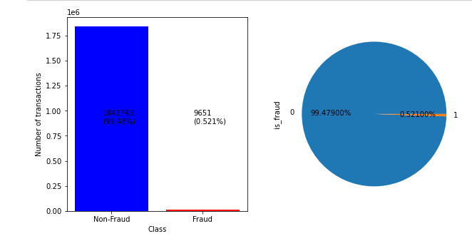
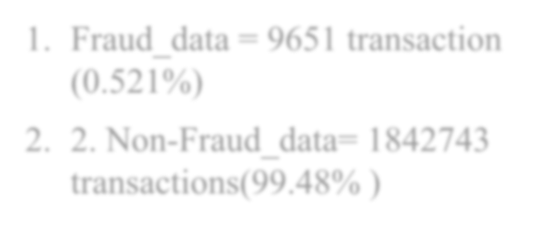
OVERVIEW OF DATA
Fraud_data = 9651 transaction
(0.521%)
2. Non-Fraud_data= 1842743 transactions(99.48% )

Slide 7
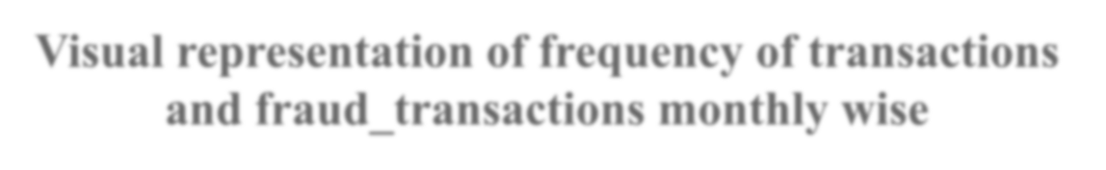
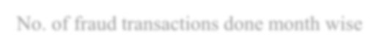
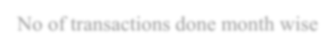


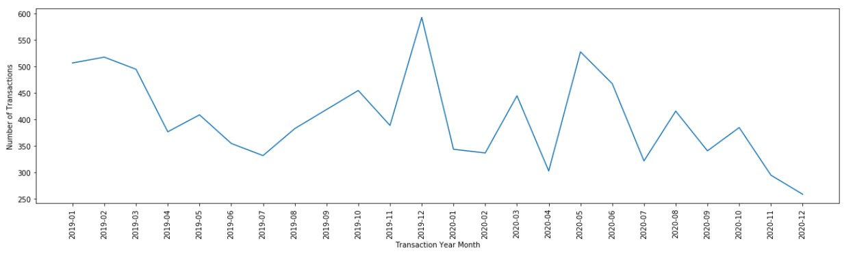
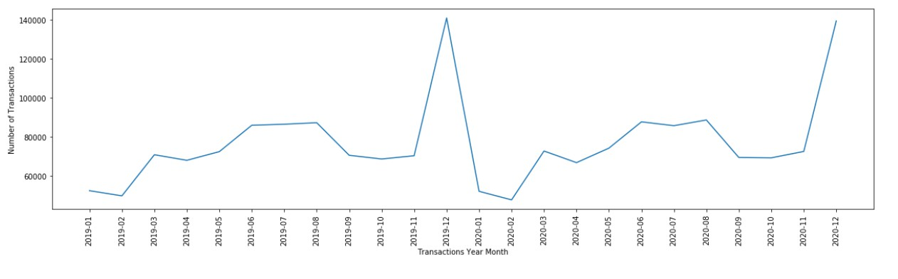
Visual representation of frequency of transactions and fraud_transactions monthly wise
No. of fraud transactions done month wise
No of transactions done month wise
Fraud transactions increased on new year eve and specifically on dec month , later on may, august , october months

Slide 8

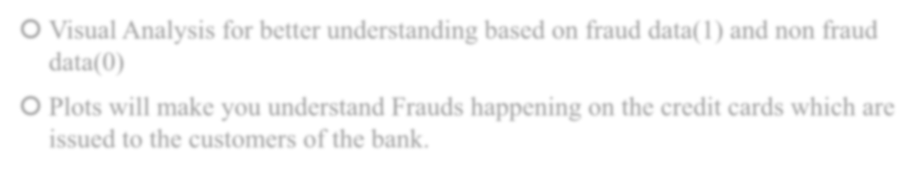
INSIGHTS
🞅 Visual Analysis for better understanding based on fraud data(1) and non fraud data(0)
🞅 Plots will make you understand Frauds happening on the credit cards which are issued to the customers of the bank.

Slide 9
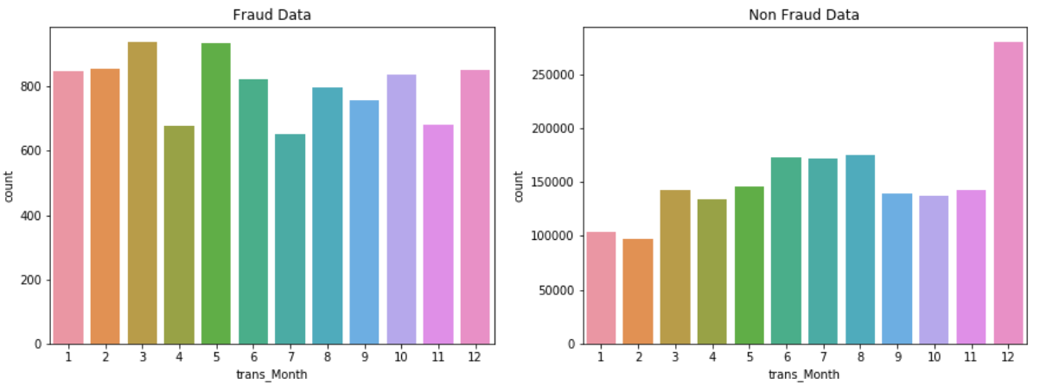
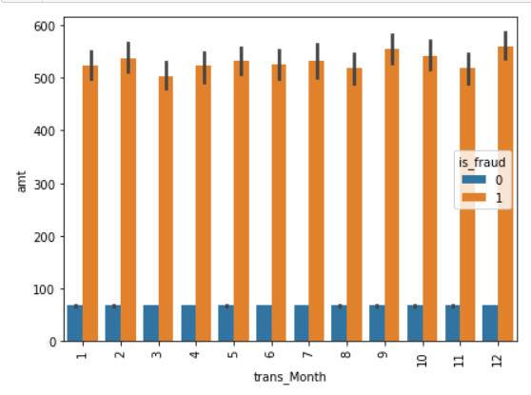
1.Analysis based on Fraud transactions in different Months
Count of frauds transactions are more in 3rd and 5th month where count of normal transaction is less.
Nearly same amount spend for fraud transactions done through out the Month.

Slide 10
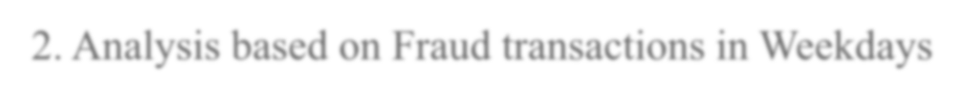
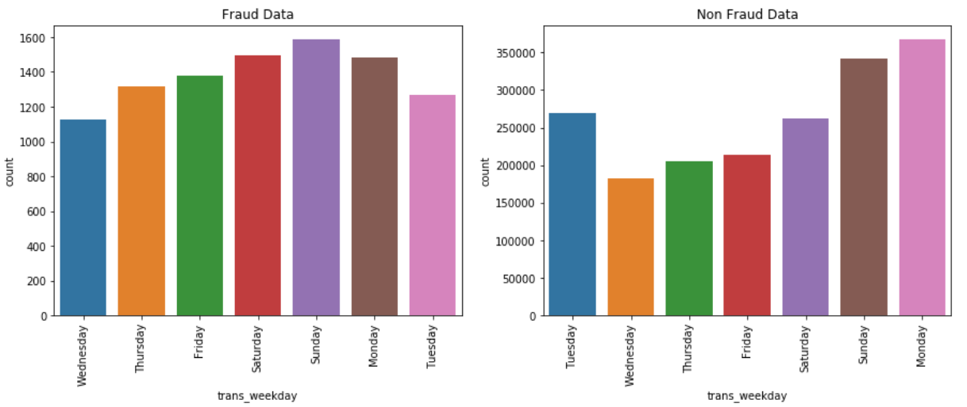
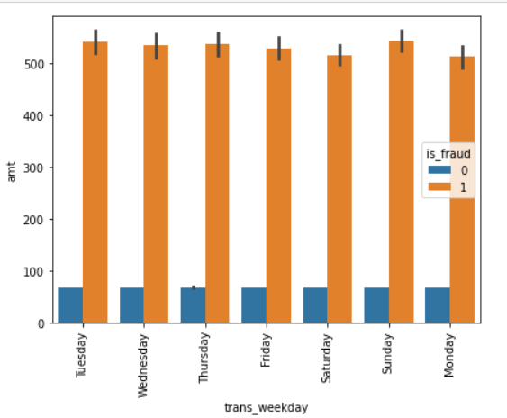
2. Analysis based on Fraud transactions in Weekdays
Count of frauds transactions are more on Sunday, Saturday and Monday as compared to the count of normal transaction
Nearly same amount spend for fraud transactions were done through out the Weekday.

Slide 11
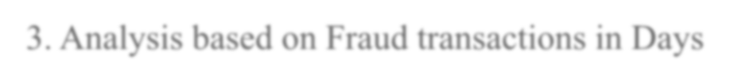
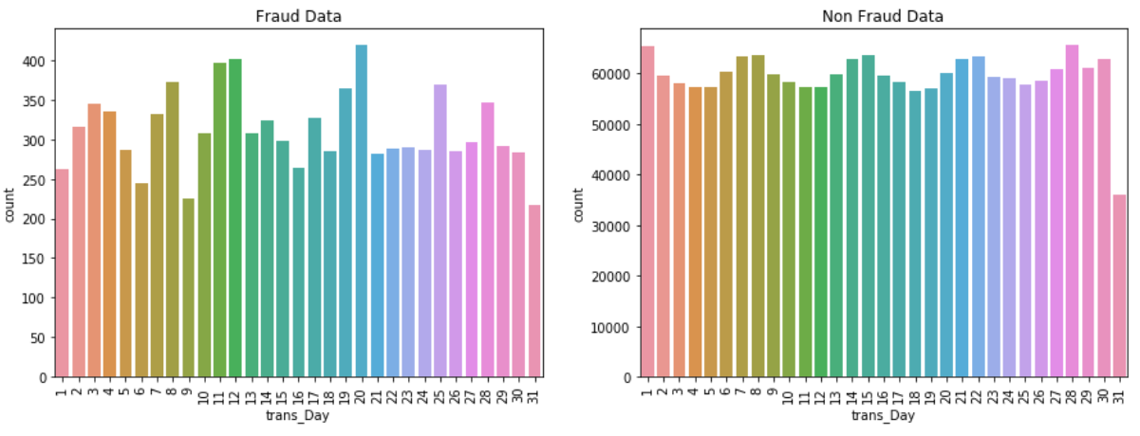
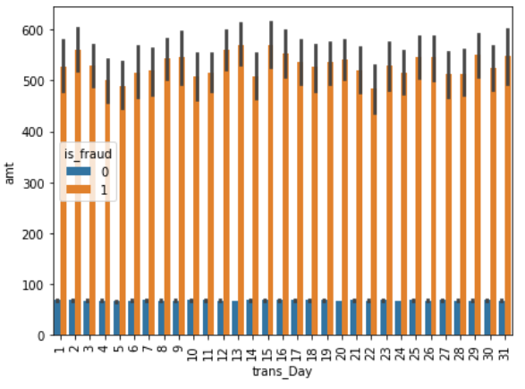
3. Analysis based on Fraud transactions in Days
Count of Frauds transactions are more on 20th, 12th and
11th days of month.
The maximum amount spend for fraud transactions are same through out the days of month.

Slide 12
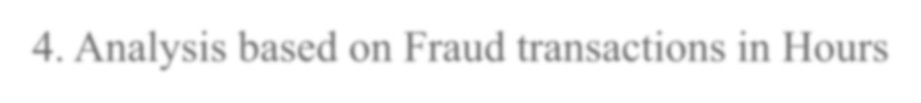
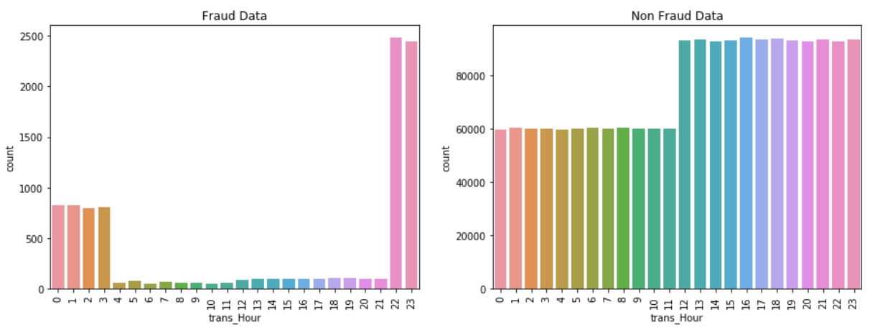
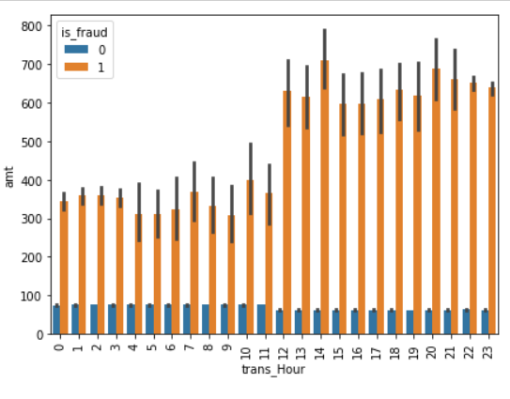
4. Analysis based on Fraud transactions in Hours
Frauds transactions are done at odd hours of the day i.e. between 22 - 3 Hr
The maximum amount spend for fraud transactions were done mostly between 12 to 23 Hr

Slide 13

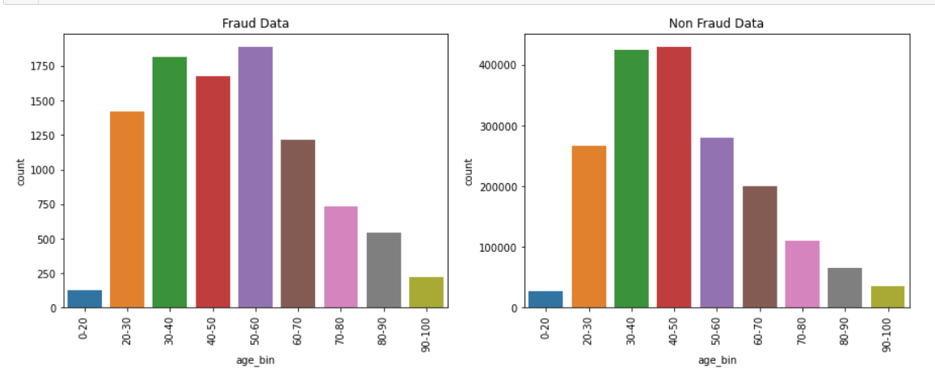
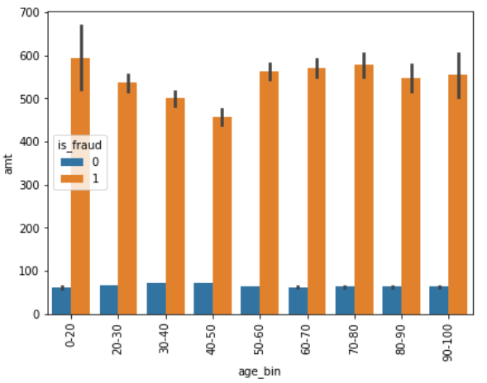
5. Analysis based on Fraud transactions in different Age_bins
The increased count of fraud transactions are noticed in the age group of 50-60 , age group of 30-40, age group of 20 to 60
The maximum amount spend for fraud transactions belongs to credit card holders "0-20", "60-70" and "70-80" age bin.

Slide 14
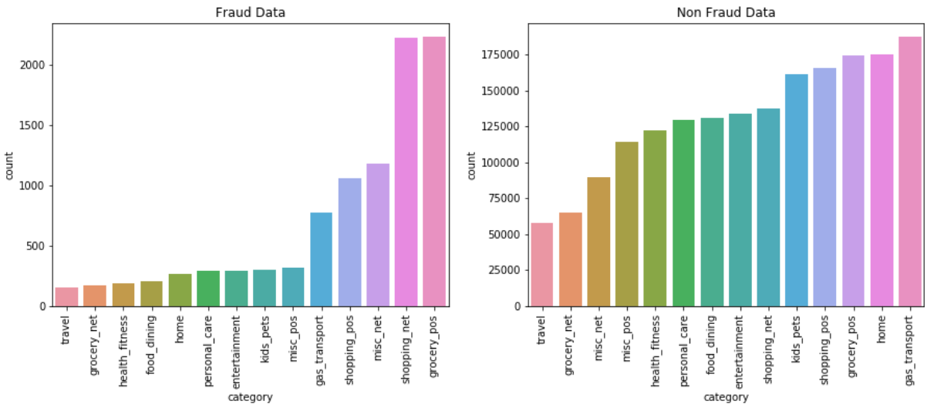

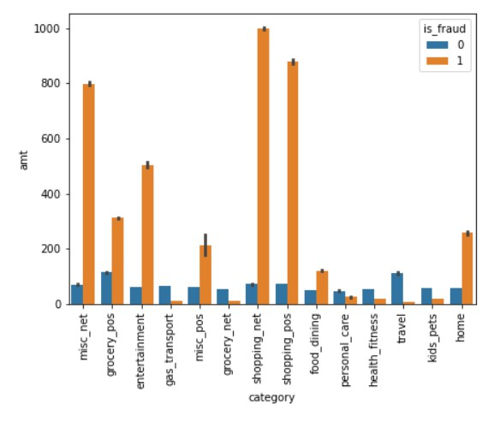
6. Analysis based on Fraud transactions in different Categories
Count of Frauds transactions are done more at grocery_pos, shopping_net, misc_net, shopping_pos, gas_transport Categories
The maximum amount spend were on shopping_net, shopping_pos, misc_net category and entertainment for fraud transactions.

Slide 15
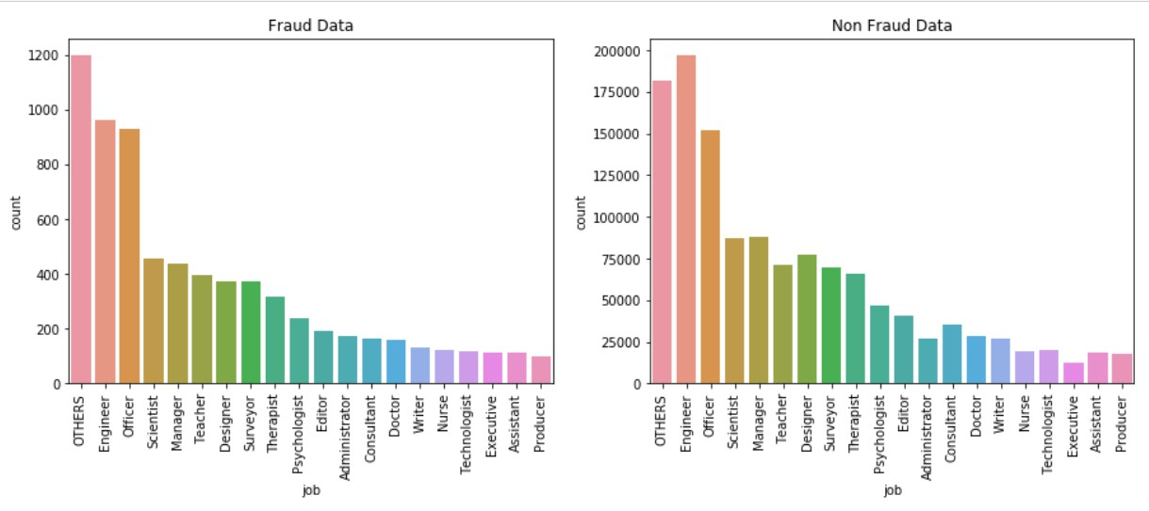

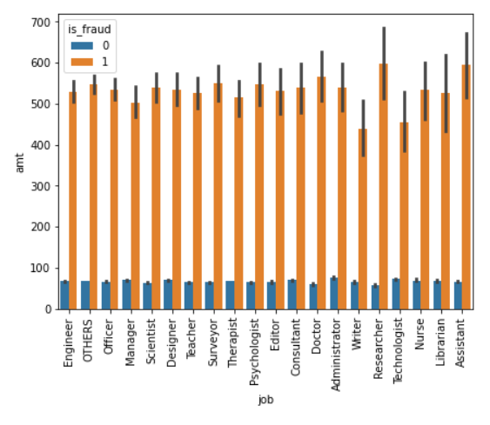
7. Analysis based on Fraud transactions in different Jobs
Count of Frauds transactions are done more Engineer, officer, others,
scientist Categories
The maximum amount spend for fraud transactions were under the job of credit card holders of Researcher, Assistant.

Slide 16
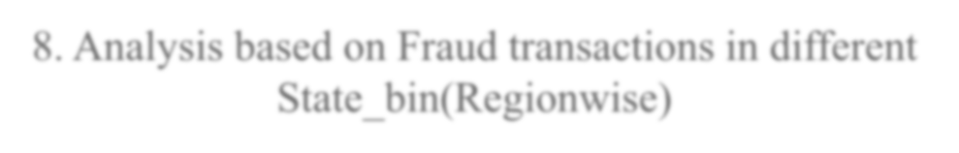
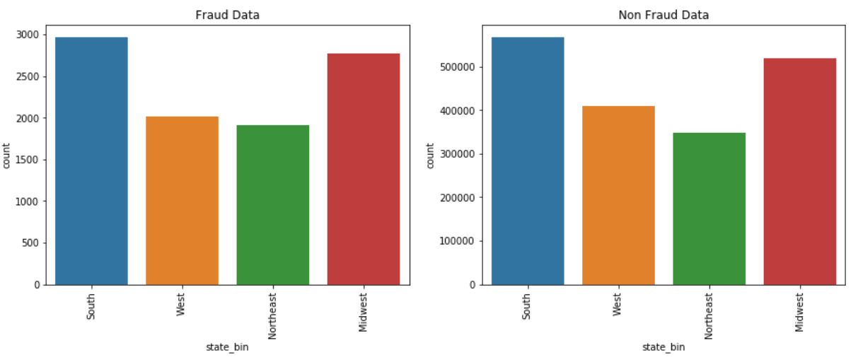

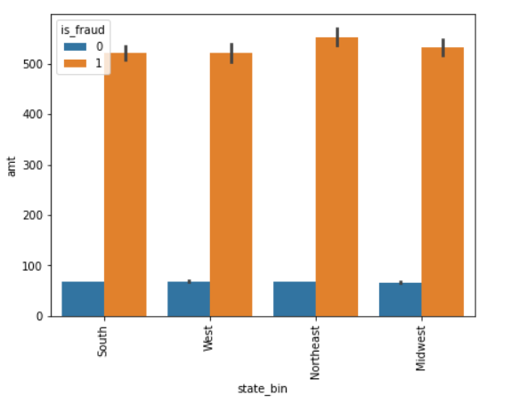
8. Analysis based on Fraud transactions in different
State_bin(Regionwise)
Count of Frauds transactions are more in South and Midwest region.
The amount spend in all the regions are same but in Northeast region is slightly more than others for fraud transactions.

Slide 17
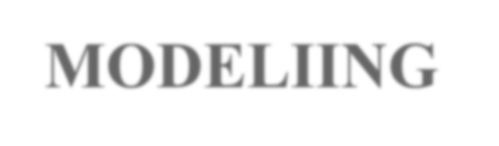
MODELIING
Flow chart of modelling
Read and understand the data
Merge the two dataset and Clean the data
Visualization of data
Feature Engineering
Conclusion
Final analysis
Modelling
Prepare the data for modelling

Slide 18

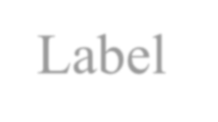
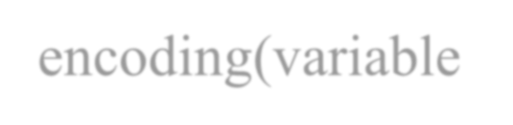
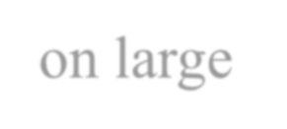
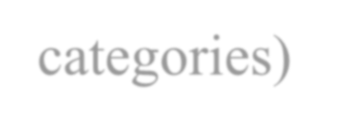
PREPARE DATA FOR MODELLING
Label encoding(variable on large categories)
Drop high correlated variables
Data ready for the splitting into X,y (train,test)
Dummy creations(variable on counted categories)

Slide 19
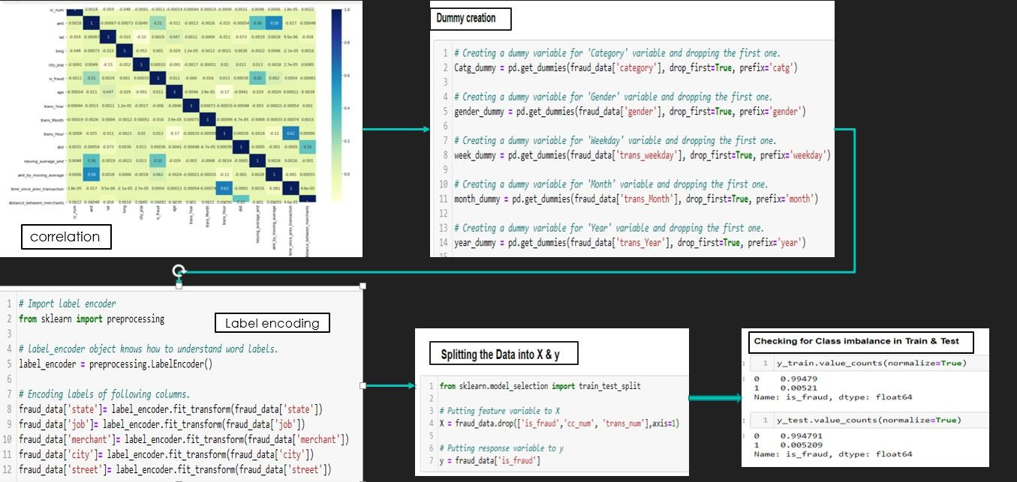
Treating the class imbalance (using SMOTE / ADASYN)
Then start
MODELLING

Slide 20

MODELLING STATS
ALGORITHM | Accuracy | Recall | F1-Score | Precision | Specificity
Decision Tree (default SMOTE) | 99.6 | 84.7 | 66.5 | 54.8 | 99.6
Decision Tree (default ADASYN) | 99.6 | 84.1 | 67.4 | 56.3 | 99.7
Decision Tree SMOTE Tuned | 99.6 | 88.8 | 56.5 | 41.4 | 99.3
Random Forests (default SMOTE) | 99.8 | 80.0 | 84.3 | 89.1 | 99.9
Random Forests (default ADASYN) | 99.8 | 77.6 | 83.6 | 90.6 | 100
Random Forests SMOTE Tuned | 99.8 | 80.0 | 84.3 | 41.1 | 99.3
XGBoost (default SMOTE) | 99.9 | 89.6 | 87.4 | 85.2 | 99.9
XGBoost (default ADASYN) | 99.9 | 89.1 | 86.7 | 84.4 | 99.9
XGBoost SMOTE Tuned | 99.9 | 89.6 | 87.4 | 85.2 | 99.9
Both the models of XGBoost i.e modelling done using default parameter using SMOTE and Hyper-tuned model using SMOTE data of XGBoost are giving same results .
Hence one of then can be used for further analysis

Slide 21


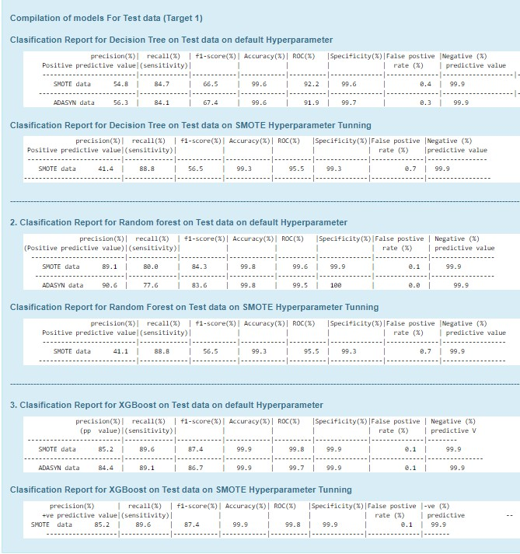
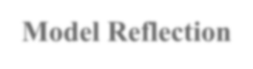
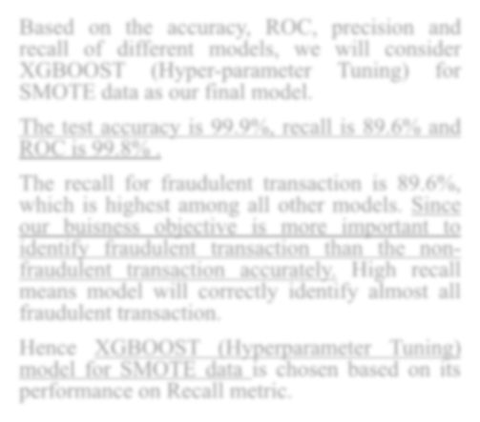
Model Reflection
Based on the accuracy, ROC, precision and recall of different models, we will consider XGBOOST (Hyper-parameter Tuning) for SMOTE data as our final model.
The test accuracy is 99.9%, recall is 89.6% and
ROC is 99.8% .
The recall for fraudulent transaction is 89.6%, which is highest among all other models. Since our buisness objective is more important to identify fraudulent transaction than the non- fraudulent transaction accurately. High recall means model will correctly identify almost all fraudulent transaction.
Hence XGBOOST (Hyperparameter Tuning) model for SMOTE data is chosen based on its performance on Recall metric.

Slide 22
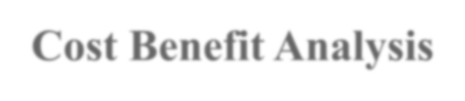
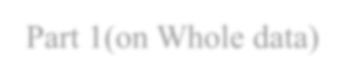

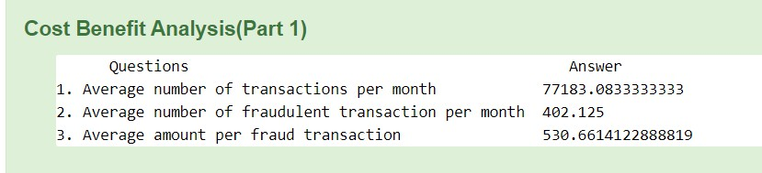
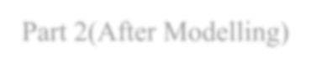

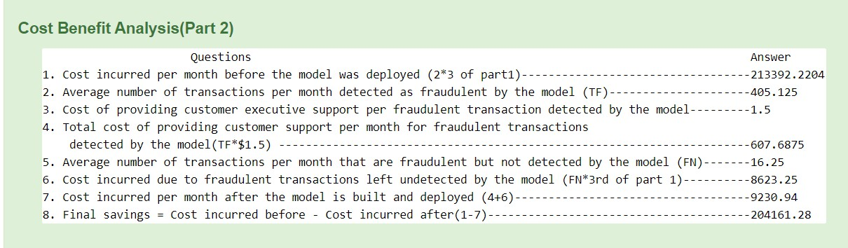
Cost Benefit Analysis
Part 1(on Whole data)
Part 2(After Modelling)

Slide 23
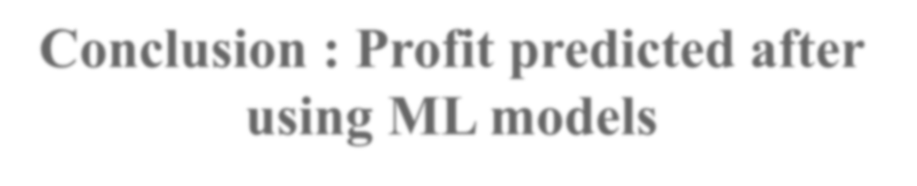









Conclusion : Profit predicted after using ML models
Savings
= $ 204161.28
Savings = Cost Incurred Before ML Model – Cost
Cost incurred per month after the model is built and deployed
=
$ 9230.94
Incurred After ML
model is Deployed
Total cost For customer support per month for fraudulent transactions detected
=
$ 607.6875
Cost Incurred Before Using ML Model
=
$ 213392.220.4
Hence 95.67% of drastic decrease in amount paid by the bank to the customer for their loss by fraud transactions using this Model.

Slide 24
Thank you

